Slide 1
Problem Statement
I was tasked with developing a comprehensive Bank Loan Report aimed at enhancing the bank's ability to monitor and assess its lending activities. The objective was to create a data-driven tool that would provide insights into critical loan-related metrics, enabling the bank to make informed decisions, track the health of its loan portfolio, and identify trends that could influence future lending strategies.
In this project, I utilized Excel's powerful features, including pivot tables, formulas, and slicers, to analyze and present key performance indicators related to bank loan activities. By leveraging these tools, I was able to efficiently organize and summarize large datasets, enabling clear insights into loan application trends, funded amounts, and borrower repayments. The use of slicers allowed for dynamic data filtering, while the application of advanced formatting ensured that the data was presented in a visually compelling and easy-to-understand manner. This comprehensive analysis helped in identifying trends and making data-driven decisions in the bank's lending strategies.

Slide 2
CONTENTS
OBJECTIVE
The primary objective of the Details Dashboard is to provide a comprehensive and user-friendly interface for accessing vital loan data. It will serve as a one-stop solution for users seeking detailed insights into our loan portfolio, borrower profiles, and loan performance.
Data Sheet
Summary Dashboard with KPI’s
Overview Dashboard with Charts
Detail Sheet with Filter
Summary
Dashboard’s

Slide 3
Key Performance Indicators (KPIs) Requirements:
Total Loan Applications: We need to calculate the total number of loan applications received during a specified period. Additionally, it is essential to monitor the Month-to-Date (MTD) Loan Applications and track changes Month-over-Month (MoM).
Total Funded Amount: Understanding the total amount of funds disbursed as loans is crucial. We also want to keep an eye on the MTD Total Funded Amount and analyze the Month-over-Month (MoM) changes in this metric.
Total Amount Received: Tracking the total amount received from borrowers is essential for assessing the bank's cash flow and loan repayment. We should analyze the Month-to-Date (MTD) Total Amount Received and observe the Month-over-Month (MoM) changes.
Average Interest Rate: Calculating the average interest rate across all loans, MTD, and monitoring the Month-over-Month (MoM) variations in interest rates will provide insights into our lending portfolio's overall cost.
5.Average Debt-to-Income Ratio (DTI): Evaluating the average DTI for our borrowers helps us gauge their financial health. We need to compute the average DTI for all loans, MTD, and track Month-over-Month (MoM) fluctuations.

Slide 4
Good Loan v Bad Loan KPI’s
In order to evaluate the performance of our lending activities and assess the quality of our loan portfolio, we need to create a comprehensive report that distinguishes between 'Good Loans' and 'Bad Loans' based on specific loan status criteria.
Good Loan KPI’s | Bad Loan KPI’s
1.Good Loan Application Percentage: We need to calculate the percentage of loan applications classified as 'Good Loans.' This category includes loans with a loan status of 'Fully Paid' and 'Current.' | 1.Bad Loan Application Percentage: Calculating the percentage of loan applications categorized as 'Bad Loans.' This category specifically includes loans with a loan status of 'Charged Off.'
2.Good Loan Applications: Identifying the total number of loan applications falling under the 'Good Loan' category, which consists of loans with a loan status of 'Fully Paid' and 'Current.' | 2.Bad Loan Applications: Identifying the total number of loan applications categorized as 'Bad Loans,' which consists of loans with a loan status of 'Charged Off.'
3.Good Loan Funded Amount: Determining the total amount of funds disbursed as 'Good Loans.' This includes the principal amounts of loans with a loan status of 'Fully Paid' and 'Current.' | 3.Bad Loan Funded Amount: Determining the total amount of funds disbursed as 'Bad Loans.' This comprises the principal amounts of loans with a loan status of 'Charged Off.'
4.Good Loan Total Received Amount: Tracking the total amount received from borrowers for 'Good Loans,' which encompasses all payments made on loans with a loan status of 'Fully Paid' and 'Current.' | 4.Bad Loan Total Received Amount: Tracking the total amount received from borrowers for 'Bad Loans,' which includes all payments made on loans with a loan status of 'Charged Off.'

Slide 5
KPI’S
Total Loan Applications
Total Funded Amount
Total Amount Received
Avg Interest Rate
Avg DTI
38.6K
$435.8M
$473.1M
12.05%
13.33%
MTD
MoM
MTD
MoM
MTD
MoM
MTD
MoM
MTD
MoM
4.3K
6.9%
$54.0M
13.0%
$58.1M
15.8%
12.4%
3.5%
13.7%
2.7%

Slide 6
Loan Status Grid View
In order to gain a comprehensive overview of our lending operations and monitor the performance of loans, aim to create a grid view report categorized by 'Loan Status.' This report will serve as a valuable tool for analyzing and understanding the key indicators associated with different loan statuses. By providing insights into metrics such as 'Total Loan Applications,' 'Total Funded Amount,' 'Total Amount Received,' 'Month-to-Date (MTD) Funded Amount,' 'MTD Amount Received,' 'Average Interest Rate,' and 'Average Debt-to-Income Ratio (DTI),' this grid view will empower us to make data-driven decisions and assess the health of our loan portfolio.
The KPI analysis revealed critical trends in loan demand, repayment patterns, and borrower financial health. By monitoring metrics like total loan applications, funded amounts, and average interest rates, we identified key periods for strategic adjustments. These insights helped optimize the loan portfolio and enhance overall financial performance.

Slide 7
In our Bank Loan Report project, we aim to visually represent critical loan-related metrics and trends using a variety of chart types. These charts will provide a clear and insightful view of our lending operations, facilitating data-driven decision-making and enabling us to gain valuable insights into various loan parameters. Below are the specific chart requirements:
1. Monthly Trends by Issue Date (Line Chart):
Chart Type: Line Chart
Metrics: 'Total Loan Applications,' 'Total Funded Amount,' and 'Total Amount Received'
X-Axis: Month (based on 'Issue Date')
Y-Axis: Metrics' Values
Objective: This line chart will showcase how 'Total Loan Applications,' 'Total Funded Amount,' and 'Total Amount Received' vary over time, allowing us to identify seasonality and long-term trends in lending activities.
Total Loan Applications by Month

Slide 8
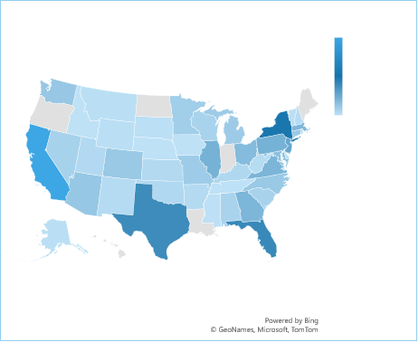
2. Regional Analysis by State (Filled Map):
Chart Type: Filled Map
Metrics: 'Total Loan Applications,' 'Total Funded Amount,' and 'Total Amount Received'
Geographic Regions: States
Objective: This filled map will visually represent lending metrics categorized by state, enabling us to identify regions with significant lending activity and assess regional disparities.
Total Loan Applications by State

Slide 9
3. Loan Term Analysis (Donut Chart):
Chart Type: Donut Chart
Metrics: 'Total Loan Applications,' 'Total Funded Amount,' and 'Total Amount Received'
Segments: Loan Terms (e.g., 36 months, 60 months)
Objective: This donut chart will depict loan statistics based on different loan terms, allowing us to understand the distribution of loans across various term lengths.
Total Loan Applications by Term:

Slide 10
4. Employee Length Analysis (Bar Chart):
Chart Type: Bar Chart
Metrics: 'Total Loan Applications,' 'Total Funded Amount,' and 'Total Amount Received'
X-Axis: Employee Length Categories (e.g., 1 year, 5 years, 10+ years)
Y-Axis: Metrics' Values
Objective: This bar chart will illustrate how lending metrics are distributed among borrowers with different employment lengths, helping us assess the impact of employment history on loan applications.
Total Loan Applications by Emp Length

Slide 11
5. Loan Purpose Breakdown (Bar Chart):
Chart Type: Bar Chart
Metrics: 'Total Loan Applications,' 'Total Funded Amount,' and 'Total Amount Received'
X-Axis: Loan Purpose Categories (e.g., debt consolidation, credit card refinancing)
Y-Axis: Metrics' Values
Objective: This bar chart will provide a visual breakdown of loan metrics based on the stated purposes of loans, aiding in the understanding of the primary reasons borrowers seek financing.
Total Loan Applications by Emp Purpose

Slide 12
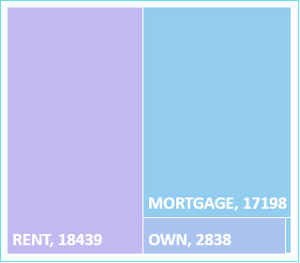
6. Home Ownership Analysis (Tree Map):
Chart Type: Tree Map
Metrics: 'Total Loan Applications,' 'Total Funded Amount,' and 'Total Amount Received'
Hierarchy: Home Ownership Categories (e.g., own, rent, mortgage)
Objective: This tree map will display loan metrics categorized by different home ownership statuses, allowing for a hierarchical view of how home ownership impacts loan applications and disbursements.
Total Loan Applications by Home
Ownership
These diverse chart types will enhance our ability to visualize and communicate loan-related insights effectively, supporting data-driven decisions and strategic planning within our lending operations."

Slide 13
In our Bank Loan Report project, we identified the necessity for a comprehensive 'Details Dashboard' to serve as a centralized repository for all crucial loan-related data. This dashboard is designed to provide a consolidated view of key metrics such as loan applications, funded amounts, repayment details, interest rates, and borrower profiles. The goal is to create a user-friendly interface that allows stakeholders to quickly access and analyze critical information, supporting data-driven decision-making and enhancing the efficiency of loan management processes.
Summary
The Details Dashboard integrates and displays essential loan metrics in one place, offering a clear and concise snapshot of the bank's lending activities. By providing real-time access to key data points, it enables users to monitor loan performance, assess borrower health, and make informed decisions. This tool is vital for improving loan portfolio management and ensuring the bank's financial stability.

Slide 14
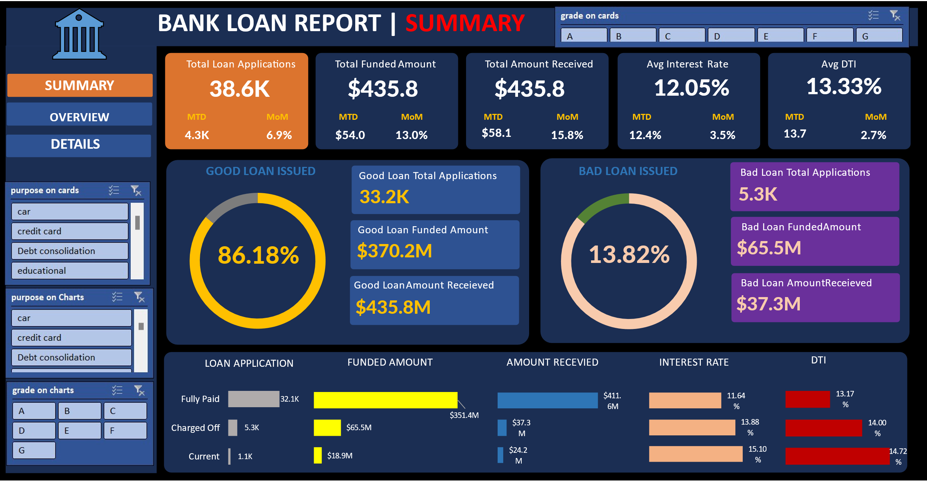

Slide 15
